Slide 1

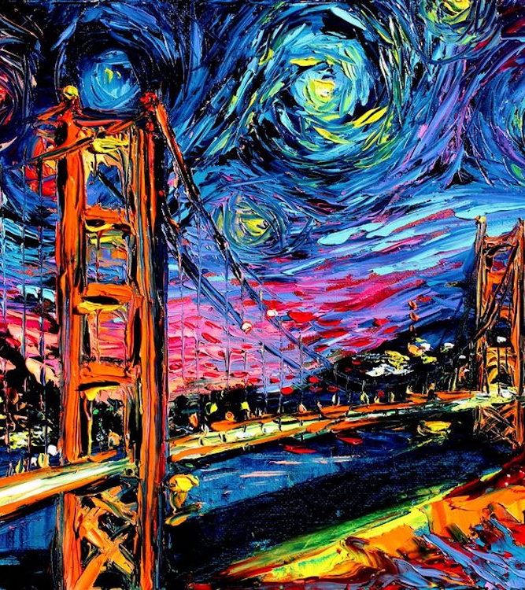
Large scale empirical study of Image stylization repositories hosted on GitHub and Stack overflow
Presenter
Projna Saha- 101194745
Ikram Hussain-101172584

Slide 2

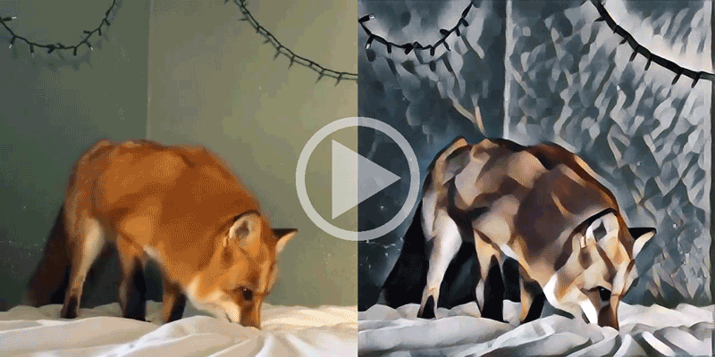

Motivation
Image stylization is to re-render the content of one image using the style of the other image. Here's an example on the left-hand side. Repositories are hosted on GitHub for the image stylization.
Tremendous work is investigated and made available online on GitHub & Stack Overflow.
The existence of numerous repositories so far, influences the business to choose the configuration for their work or research.
Need to produce a shred of evidence using detailed analysis among the state-of-the-art works

Slide 3



Research Goal
Trend analysis
Popular Languages
Publication related to repositories
Methods Used
Dataset Used
Accuracy for methods used using various classifiers
Safety Analysis for GitHub
Difficulty level Stack Overflow Q/A’s
Popularity Level
Safety Analysis for Stack Overflow

Slide 4
GitHub

Slide 5
Methodology
Keyword search
Data cleaning
Methods used
Dataset Used
Accuracy of Methods Using Classifiers
Trend Analysis
Popular Language
Publication related to Repositories
Safety Analysis

Slide 6
Dataset cleaning | GitHub
Keyword
“Image Stylization”
98
Repositories
02 Web Development
94 Image Stylization
02 Null Repositories

Slide 7
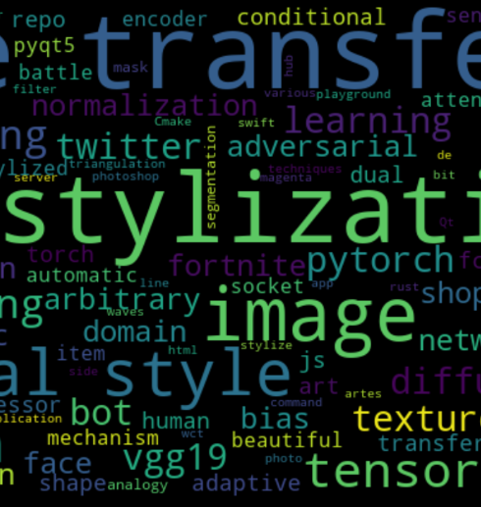
GitHub Word cloud for frequently used tags
Style transfer
Image stylization
Deep learning
Vgg16
Vgg19
Arbitrary style transfer
pytorch
CNN transfer
Pyqt5

Slide 8
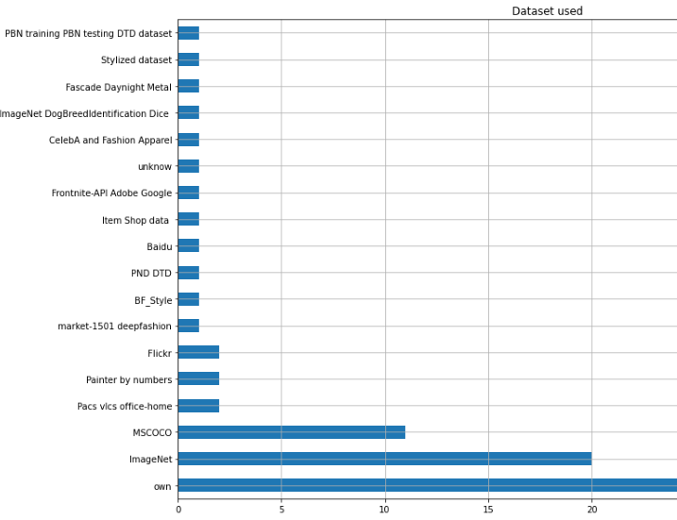
Dataset used in GitHub

Slide 9
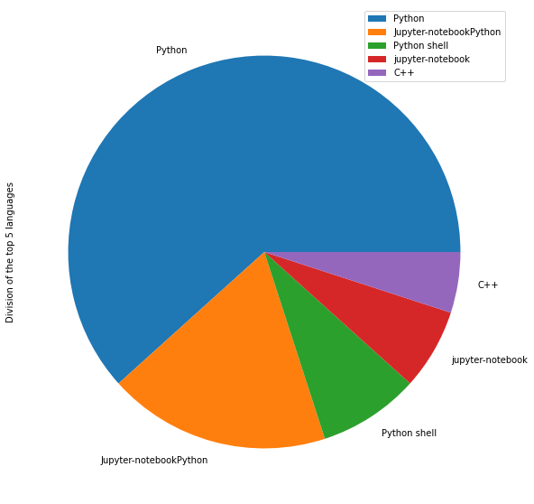
Language Mostly used
Python
Jupyter-notebookPython
Python Shell
Jupyter-notebook
C++

Slide 10

Results from analysis | GitHub

Slide 11
Accuracy for methods used using various classifiers
Classification Method | Accuracy
 | Without feature selection | With Chi-square | With PCA
SVM | ﻿ 0.7368 | ﻿ 0.7368 | ﻿ 0.7368
KNN | 0.6842 | 0.7894 | 0.7368
Adaboost | 0.5789 | 0.7368 | 0.6842
Logistic Regression | 0.6842 | 0.7368 | 0.7368
Gaussian Naïve Bayes | 0.4210 | 0.3682 | 0.3684
Random Forest | ﻿ 0.6842 | 0.7368 | 0.6315
MLP | 0.6842 | 0.7368 | 0.6842
Stochastic Gradient descent | ﻿0.6842 | ﻿0.7894 | ﻿0.6315
Passive aggressive | ﻿0.7368 | ﻿0.5789 | ﻿0.6842
Ridge | ﻿0.7368 | ﻿0.7368 | ﻿0.7368

Slide 12
Accuracy for methods used before and after diagonalization
Classification Method | Accuracy
 | Before diagonalization | After diagonalization
Max likelihood | ﻿ 0.60 | ﻿0.60
Bayesian | 0.70 | 0.70
Ho-Kashyap Rule | 0.66 | 0.66
Fisher’s Discriminant | 0.60 | 0.60

Slide 13
Quality evaluation method
Most of the repositories did the Subjective Analysis
Only 2.2% did the Objective Analysis.

Slide 14
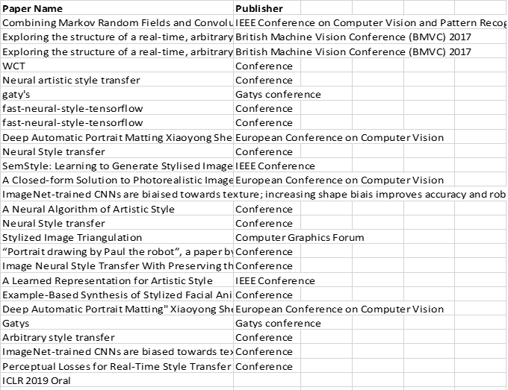
Publication related to repositories
Inquiry:
Found 55 publications related to repositories.
Own work- 38 repositories
Most of the papers are Conference Papers
There is no Journal paper found from the repository

Slide 15

Trend analysis | GitHub
2012
Oldest
2020
Boom period

Slide 16
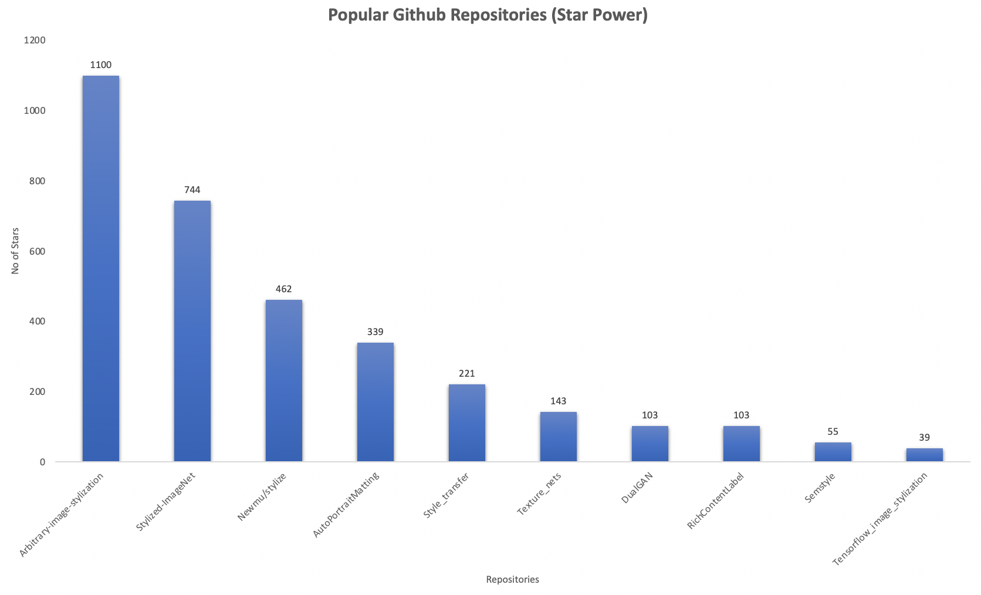
Popularity of GitHub Repositories

Slide 17
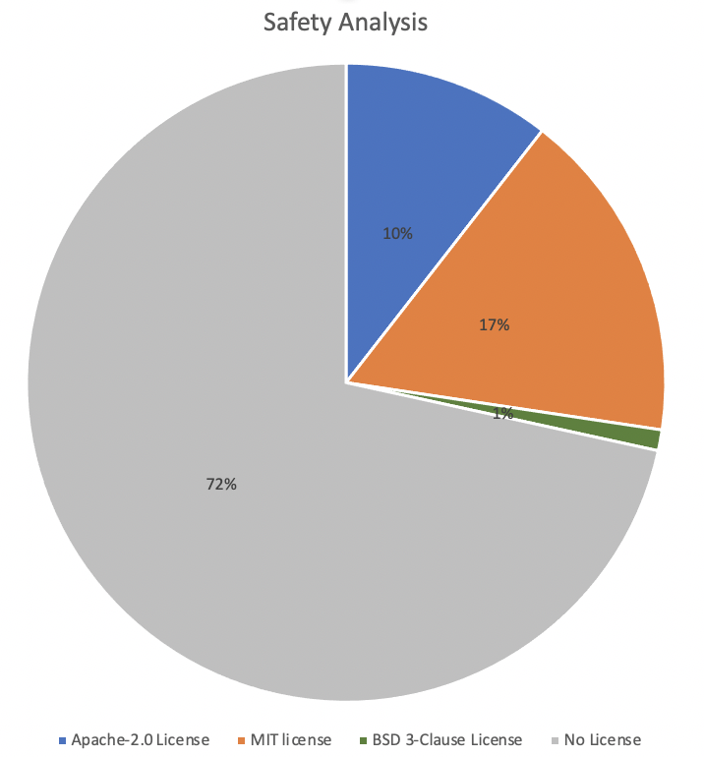
Safety analysis
To gauge the quality of work we did safety analysis to see the GitHub repository is related to a publication or not. We also checked the licenses of each repositories that shown in the pie chart.
Result Shows:
72% of the repositories do not License.
17% has the MIT License
10% has the Apache-2.0 License
1% has the license, named “BSD-Clause License”

Slide 18
Stack overflow

Slide 19
Methodology
Keyword Search “Image Stylization”
Difficulty Level
Popularity Level
Dataset Cleaning
Trend Analysis
Safety Analysis

Slide 20
Dataset cleaning | stack overflow
Keyword
“Image Stylization”
294
Repositories
270 Web Development
24 Image Stylization

Slide 21
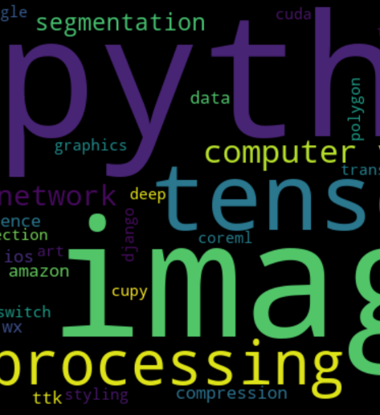
Stack overflow Word cloud for frequently used tags
Image
Python
TensorFlow
OpenCV
Processing neural
Computer vision
Pyqt5
Android
Segmentation
Android

Slide 22
Difficulty level | Stack overflow

Slide 23
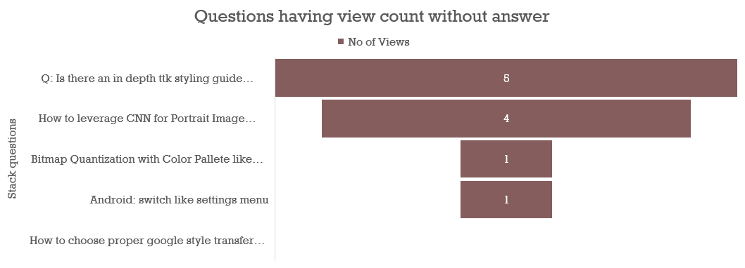
Difficulty level | Stack overflow

Slide 24
Popularity level | Stack overflow

Slide 25

Trend analysis | stack overflow
2012
Oldest
2020
Boom period

Slide 26
Safety analysis | Stack overflow

Slide 27

Threats and limitations
Although we have checked the difficulty level by measuring the time it is taken to answer a Stack Overflow question, we cannot justify that result using a reference. And that could be one of the reasons that they do not have the experts in this area.
The sample data is low, and we mitigate the risk by not filtering data for 10 years but took all the available related data.

Slide 28
Implications
Our work is helpful for those who are interested in image stylization and what work has been already done. They will find implementation of many published papers here. And can use them for modification and further studies.
Deep learning techniques are widely used
Subjective tests are mostly used for evaluation purposes, so there is a gap for researchers for more trusted objective quality metrics
For safety purpose, those who create new repositories can have license information
Demo videos can help readers understanding
Implementation on online platforms, such as google Colab is convenient for users that will enhance the reproducibility

Slide 29
Validation of our work
Manual inspection of tags/labels
Cleaning data by contents and size
Whitening by applying diagonalization
Use ML to classify data and use PCA and chi square for feature selection
Used five-fold cross validation.

Slide 30
References
[1] GONZALEZ, DANIELLE, THOMAS ZIMMERMANN, AND NACHIAPPAN NAGAPPAN. "The State of the ML-universe: 10 Years of Artificial Intelligence & Machine Learning Software Development on GitHub." Proceedings of the 17th International Conference on Mining Software Repositories. 2020.
[2] Abdellatif, A., Costa, D., Badran, K., Abdalkareem, R., & Shihab, E. (2020). Challenges inchatbot development: A study of stack overflow posts. InIn 17th international conferenceon mining software repositories (msr ’20).New York, NY, USA: IEEE.

Slide 31


